Slide 1
Text to Speech Converter Using Amazon Polly | Python Tkinter & Boto3 |

Slide 2
Why AWS Polly
High-quality voices: AWS Polly offers a wide range of high-quality, lifelike voices in multiple languages and dialects. These voices use advanced neural text-to-speech technology to produce human-like speech that is easy to understand and engaging.
Easy to integrate: AWS Polly can be easily integrated into your existing applications and workflows using its API or SDKs. You can also use the AWS Management Console to manage your Polly resources.
Scalability: AWS Polly is a scalable service that can handle large volumes of text-to-speech requests. This means you can use it to generate speech in real-time or in batches, depending on your needs.
Cost-effective: AWS Polly offers a pay-as-you-go pricing model, which means you only pay for the amount of speech you generate. This makes it a cost-effective solution for businesses of all sizes.

Slide 3
Steps
Create a Python GUI using Tkinter
Using Boto3 as backend.
Connect Polly to gui using boto3
Give the output.

Slide 4
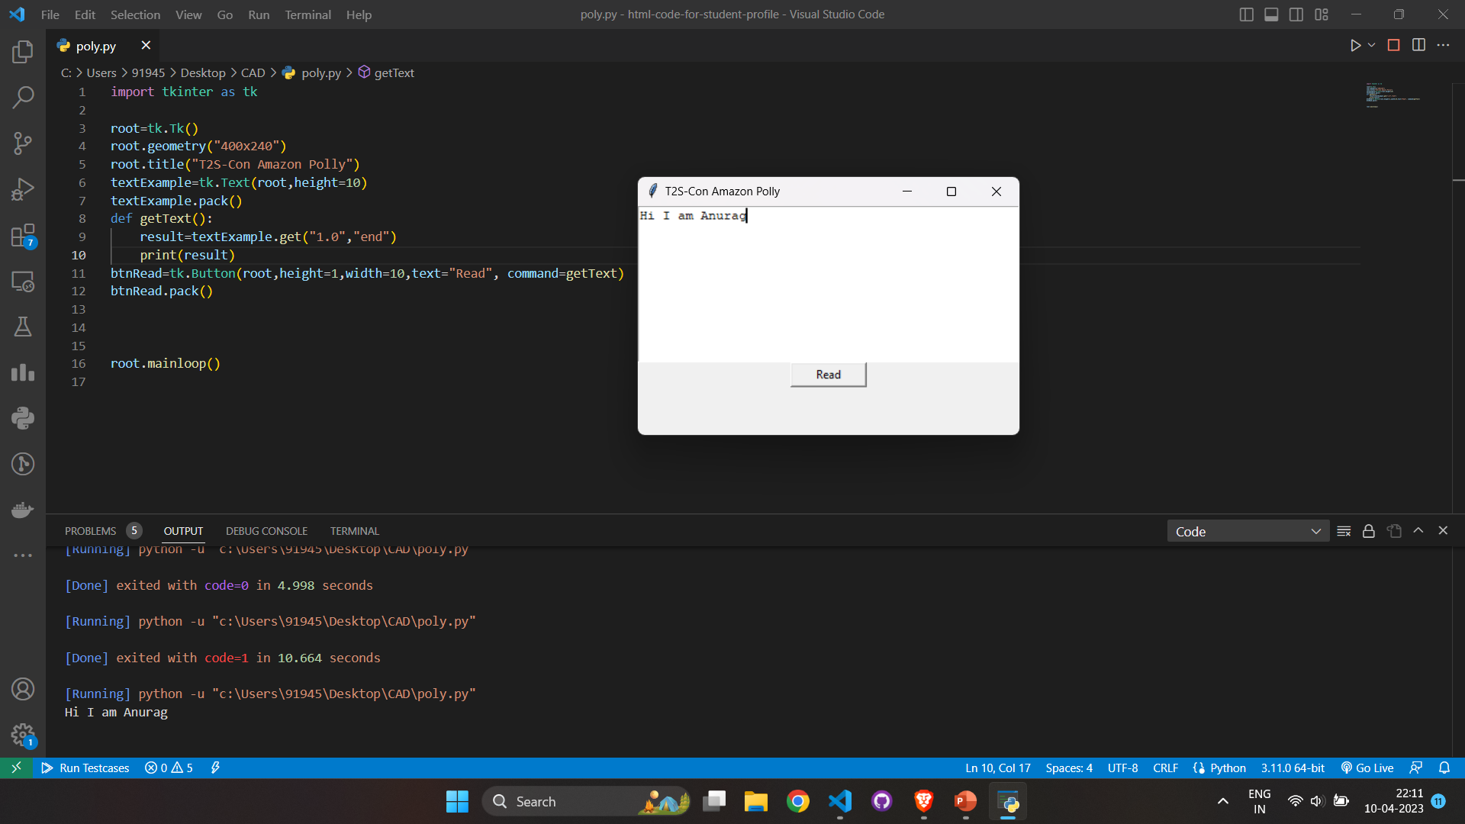
Python GUI

Slide 5
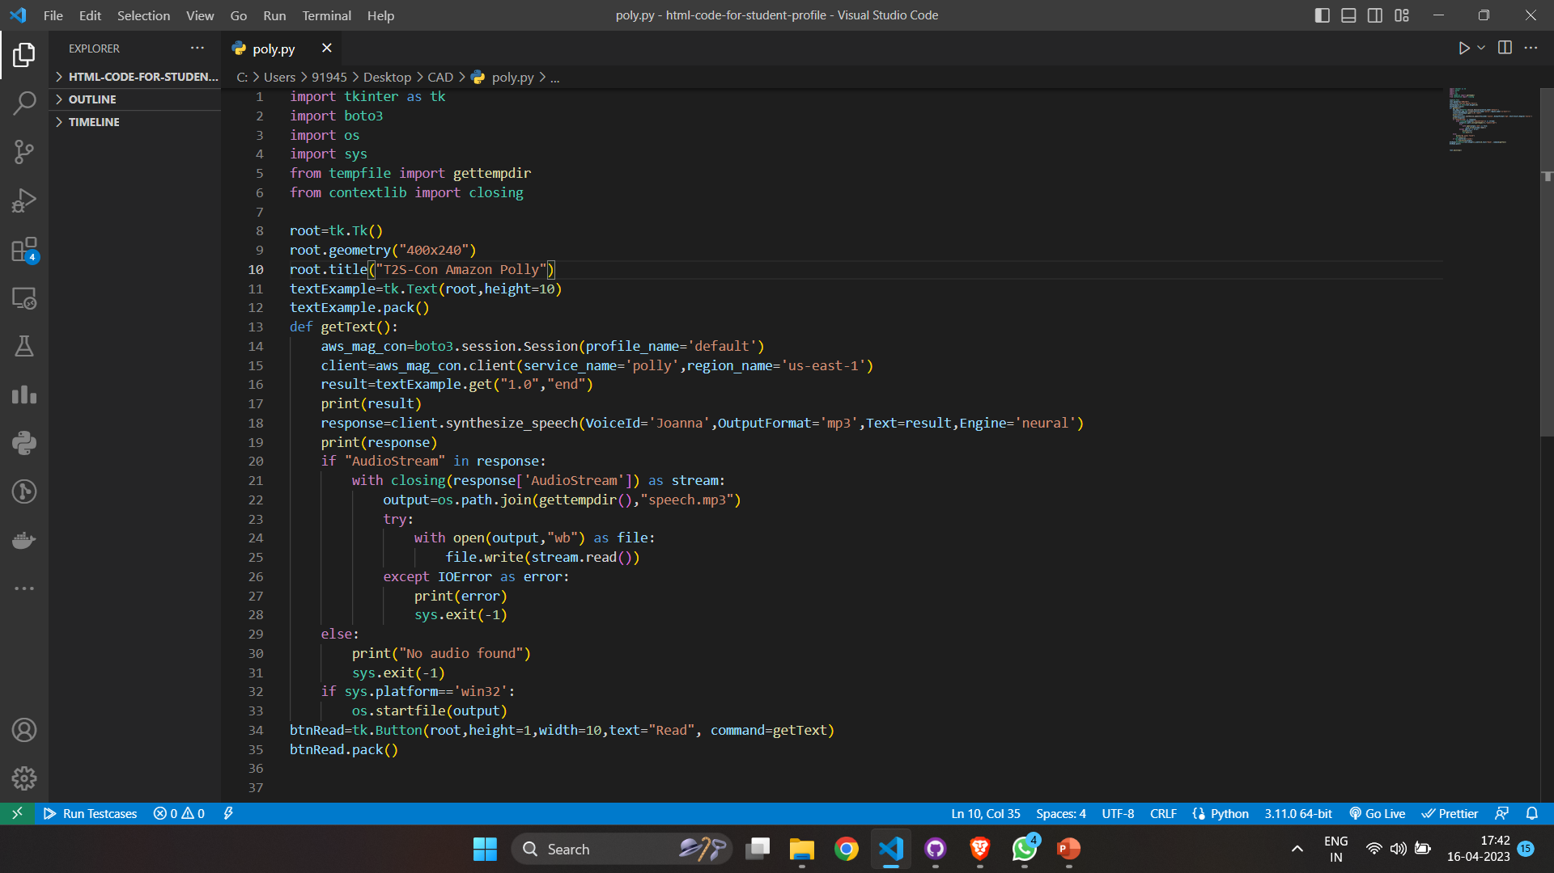
Boto3 script for using Amazon Polly

Slide 6
How this works?
We connect AWS Management Console to our Script using Boto3
We define the service used as – Polly
We define all necessary details like- Voice-Id, Output Format etc.
The input is taken from the text area in the Gui and then sent to Polly
It converts the text into a mp3 file which can be listened in the system.
Working Video Link-

Slide 7
Thank You

